Slide 1
Cryptocurrencies and Blockchain Technologies
CS251 Fall 2021
(https://cs251.stanford.edu)
Dan Boneh Benedikt Bünz
Stanford University
[videos on canvas, discussions on edstem, homework on gradescope]

Slide 2
What is a blockchain?
Abstract answer: a blockchain provides
coordination between many parties,
when there is no single trusted party
if trusted party exists ⇒ no need for a blockchain
[financial systems: often no trusted party]
Notes:
but blockchains also used in other areas, like digital asset management, e.g., as in online games.

Slide 3
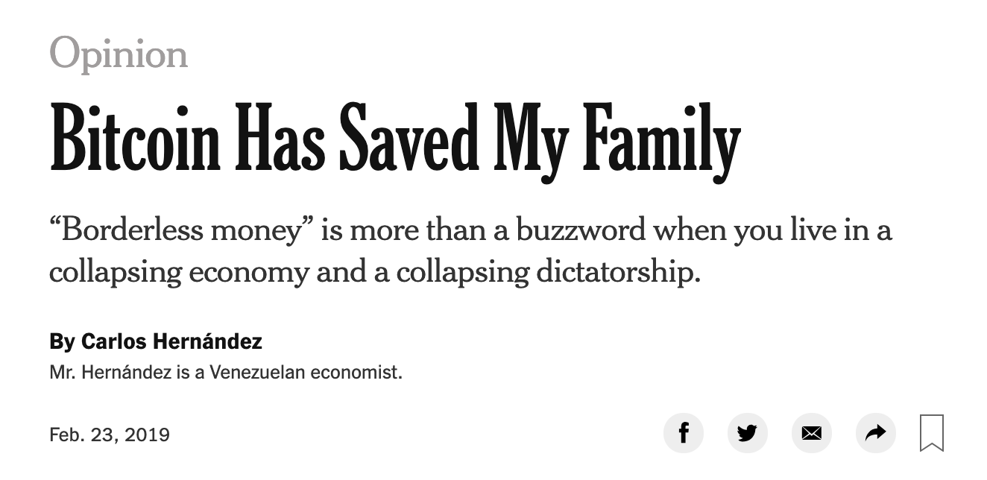

What is all the excitement about?
(1) Basic application: a digital currency (stored value)
Current largest: Bitcoin (2009), Ethereum (2015)
Global: accessible to anyone with an Internet connection

Slide 4
What is all the excitement about?
(2) Beyond stored value: decentralized applications (DAPPs)
DeFi: financial instruments managed by public programs
examples: stablecoins, lending, exchanges, ….
Asset management (NFTs): art, game assets, domain names.
Decentralized organizations (DAOs): (decentralized governance)
DAOs for investment, for donations, for collecting art, etc.
(3) New programming model: writing decentralized programs

Slide 5
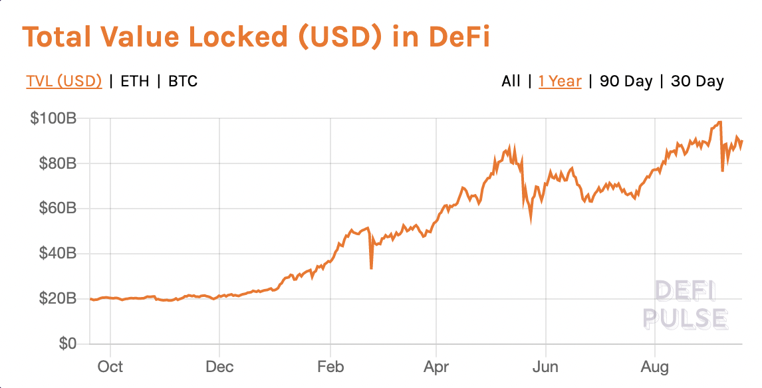
Assets managed by DAPPs
Sep. 2021

Slide 6
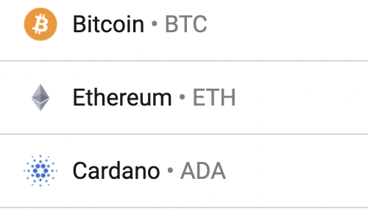
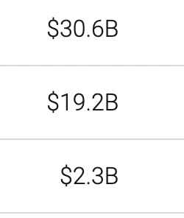
Transaction volume
24h volume Sep. 2021

Slide 7
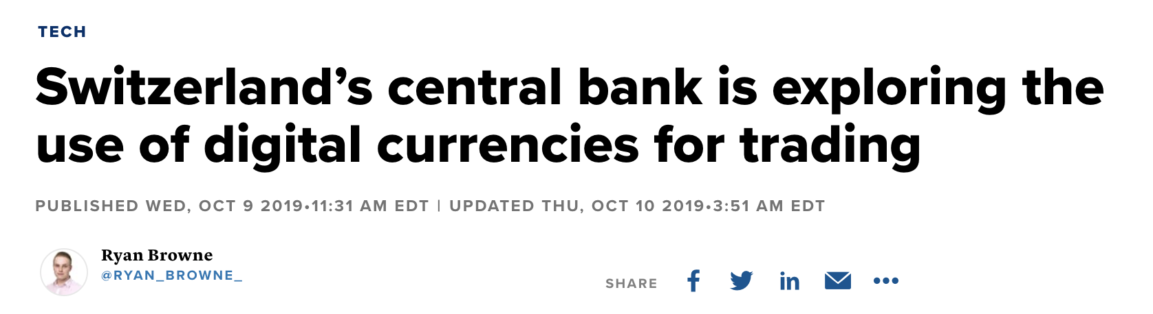
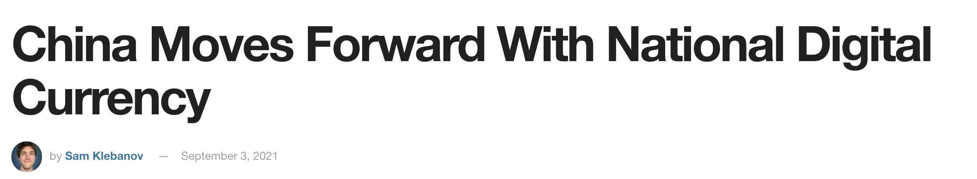
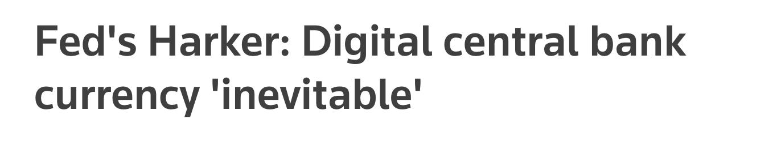
Central Bank Digital Currency (CBDC)
30 central banks actively working on retail CBDC
[BIS survey Jan. 2019]
Notes:
NSD: Russian National Settlement Depository.

Slide 8
What is a blockchain?
user facing tools (cloud servers)
applications (DAPPs, smart contracts)
compute layer (blockchain computer)
consensus layer

Slide 9
Consensus layer (informal)
achieved by replication
A public append-only data structure:
Persistence: once added, data can never be removed*
Safety: all honest participants have the same data**
Liveness: honest participants can add new transactions
Open(?): anyone can add data (no authentication)
consensus layer
Notes:
[Pass, Seeman, Shelat, 2016]
Blockchain data needs to be public: private blockchains are not part of this course.

Slide 10
How are blocks added to chain?
blockchain
signed
I am the leader
2 ETH
sk_{A}
verify
block
verify
block
sk_{B}
sk_{C}

Slide 11
How are blocks added to chain?
blockchain
…
2 ETH
I am the leader
sk_{A}
sk_{B}
2 ETH
sk_{C}
Notes:
Like a cloud service paid for by inflation.

Slide 12
Why is consensus a hard problem?
Tx1, Tx2, Tx3, Tx4
Tx1, Tx2, Tx3, Tx4
Tx1
Tx3
Tx2
Tx4
Tx1, Tx2, Tx3, Tx4
Tx1, Tx2, Tx3, Tx4

Slide 13



Why is consensus a hard problem?
Tx1, Tx2, Tx3, Tx4
Tx1, Tx2, Tx3, Tx4
Tx1
$$∆$$
Tx3
Problems:
Network delay
Network partition
Tx2
Tx4
$$∆$$
Tx1, Tx2, Tx3, Tx4
Tx1, Tx2, Tx3, Tx4
Notes:
In case of network partition: can stop accepting transactions (Paxos), or can accept transactions and resolve fork once partition heals (Bitcoin).

Slide 14

Why is consensus a hard problem?
Tx1, Tx2, Tx4
Tx1
Problems:
crash
malice
Tx2
Tx4
Tx1, Tx2, Tx4
Tx1, Tx2, Tx4
Notes:
Goal: security when 51% of nodes are honest.

Slide 15
The blockchain computer
DAPP logic is encoded in a program that runs on blockchain
Rules are enforced by a public program (public source code)
⇒ transparency: no single trusted 3rd party
The DAPP program is executed by parties who create new blocks
⇒ public verifiability: everyone can verify state transitions
compute layer
consensus layer

Slide 16
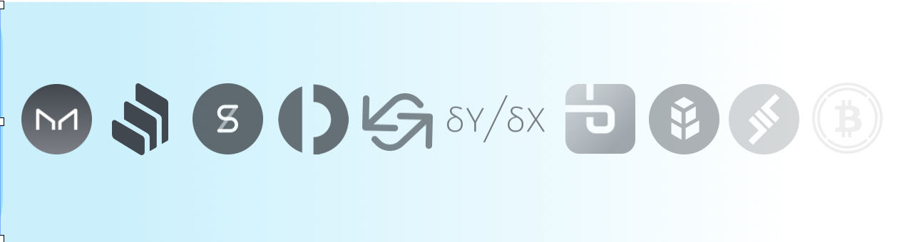
Decentralized applications (DAPPS)
Run on blockchain
computer
applications (DAPPs, smart contracts)
blockchain computer
consensus layer

Slide 17
Common DAPP architecture
Top layer: user facing servers
end user
blockchain computer
DAPP
DAPP
DAPP
on-chain state
consensus layer

Slide 18
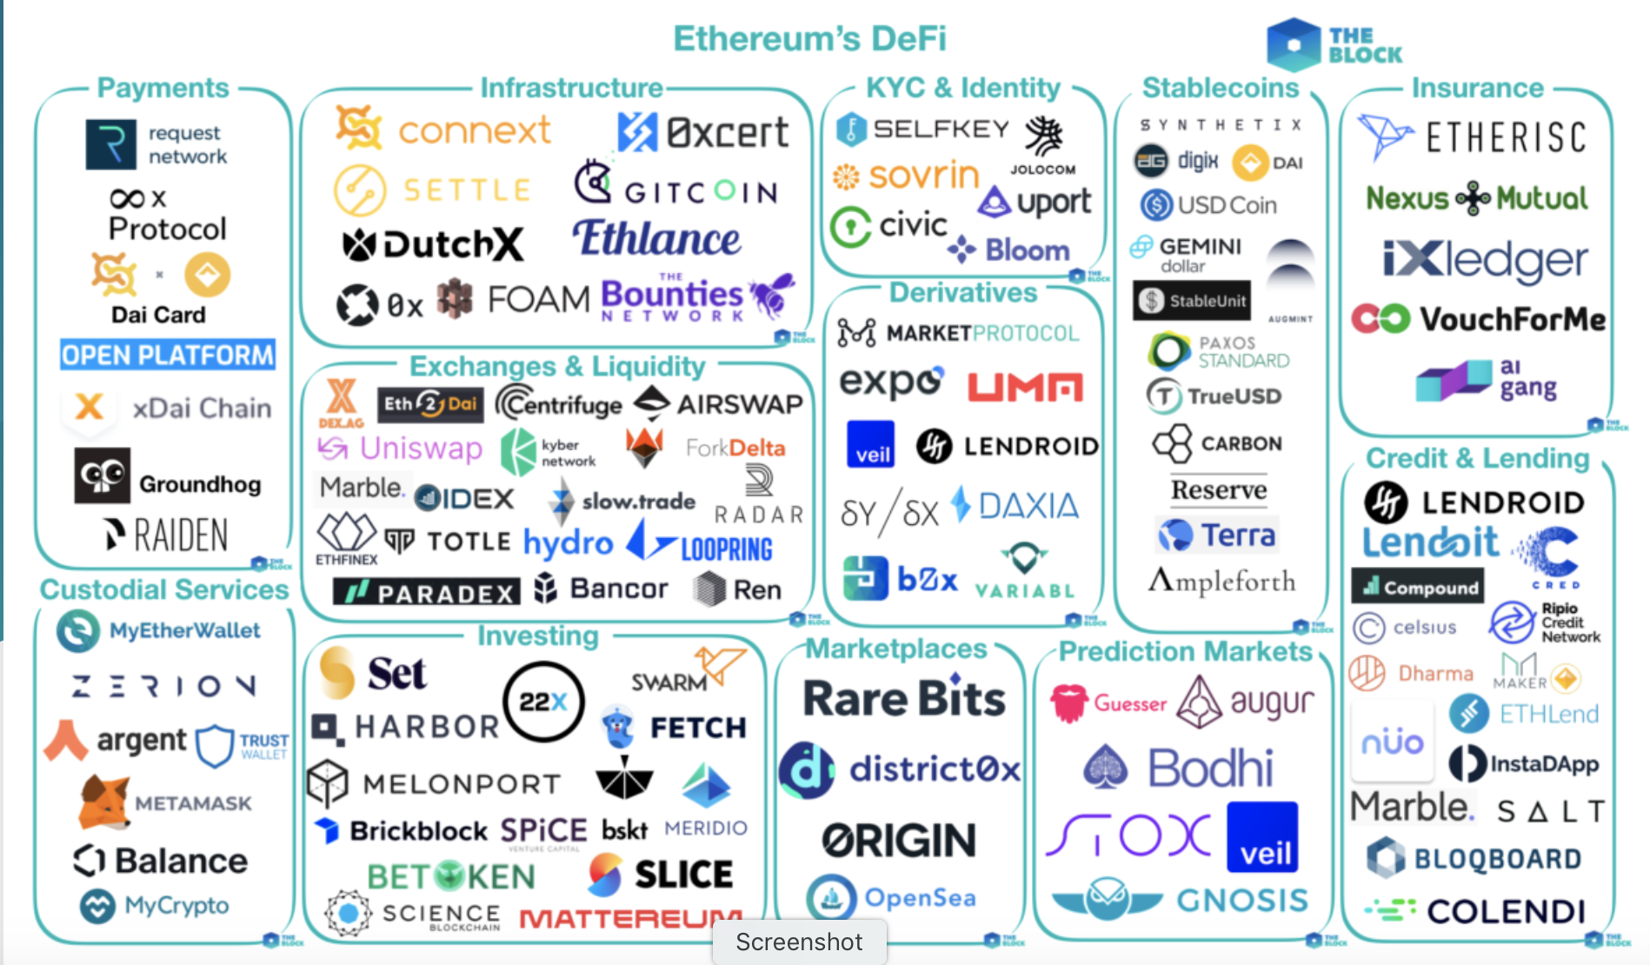
[source: the Block Genesis]
Notes:
By the end of the course: you will know how to write your own DAPP.

Slide 19
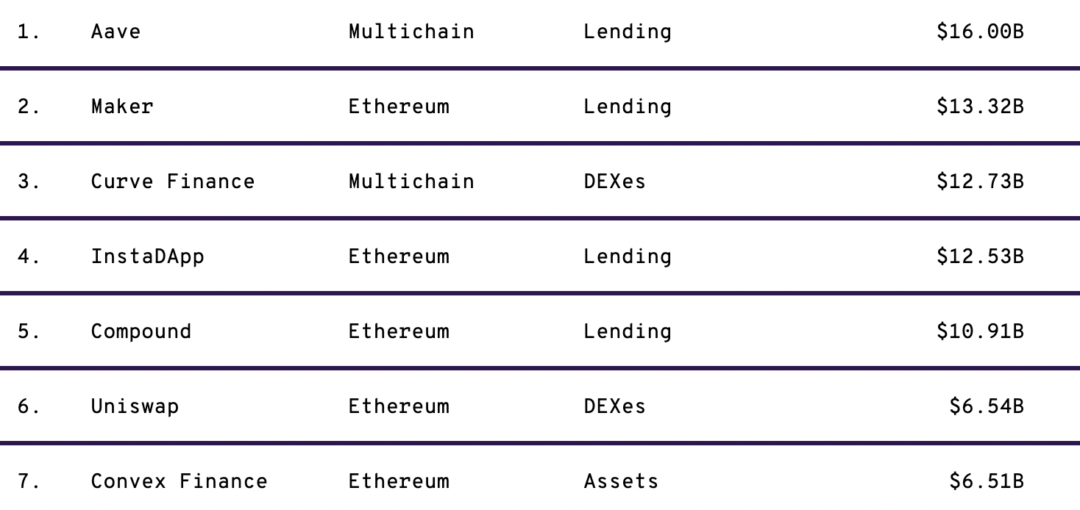
lots of experiments …
locked

Slide 20

This course
Cryptography
Distributed systems
Economics

Slide 21
Course organization
The starting point: Bitcoin mechanics
Consensus protocols
Ethereum and decentralized applications
Economics of decentralized applications
Scaling the blockchain: 10K Tx/sec
Private transactions on a public blockchain (SNARKs and zero knowledge proofs)
Interoperability among chains: bridges and wrapped coins

Slide 22
Course organization
cs251.stanford.edu
Three homework problems, four projects, final exam(?)
Optional weekly sections on Friday
Please tell us how we can improve … Don’t wait until the end of the quarter

Slide 23
Let’s get started …

Slide 24
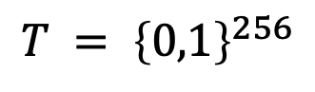
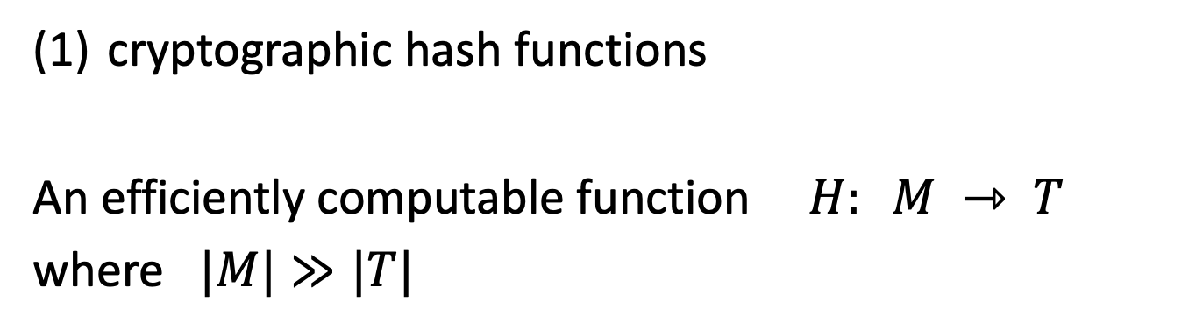
Cryptography Background
cryptographic hash functions
An efficiently computable function $H: M ⇾ T$
where $|M|≫|T|$
32 bytes
megabytes
hash value
$$T = {\left\{0,1\right\}}^{256}$$

Slide 25
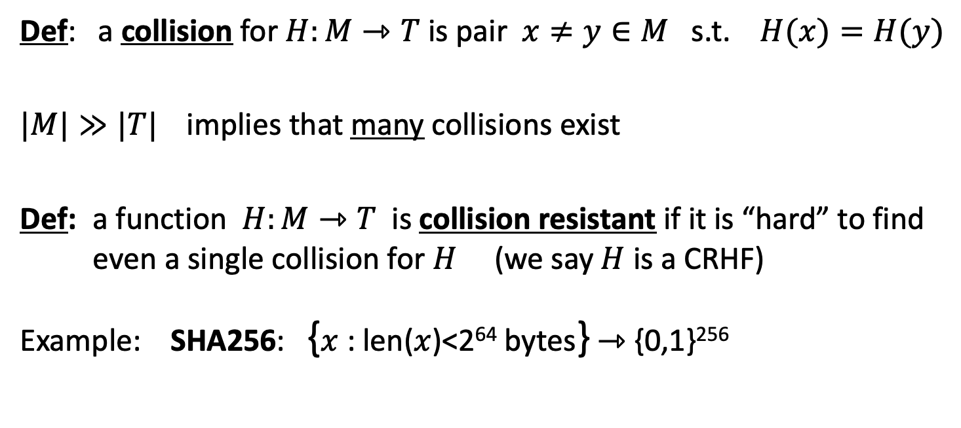
Collision resistance
Def: a collision for $H:M⇾T$ is pair $x≠y∈M$ s.t. $H(x)=H(y)$
$|M|≫|T|$implies that many collisions exist
Def: a function $H:M⇾T$ is collision resistant if it is “hard” to find even a single collision for $H$ (we say $H$ is a CRHF)
Example: SHA256: {$x$ : len($x$)<2⁶⁴ bytes} ⇾ {0,1}²⁵⁶
details in CS255

Slide 26
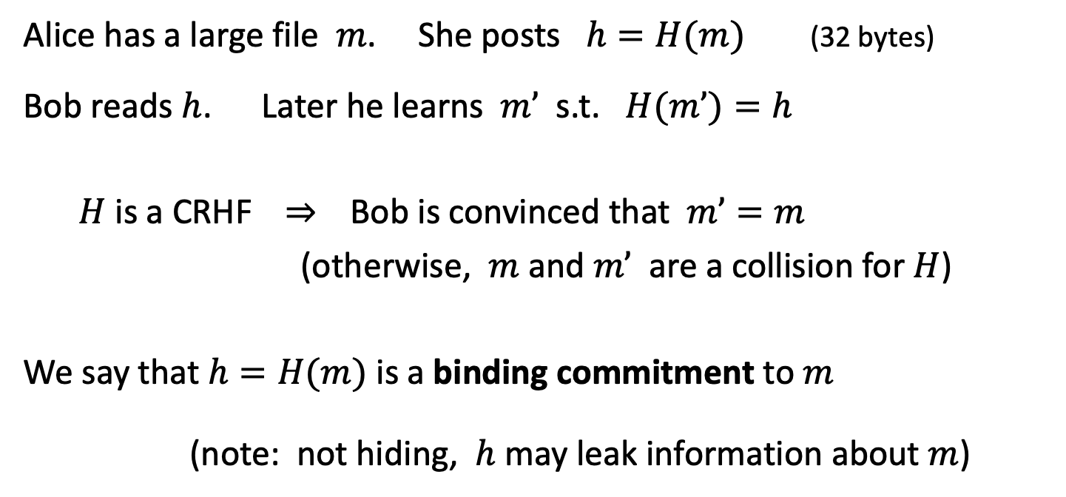
Application: committing to data on a blockchain
Alice has a large file $m$. She posts $h=H(m)$(32 bytes)
Bob reads $h$. Later he learns $m’$ s.t. $H(m’)=h$
$H$ is a CRHF ⇒ Bob is convinced that $m’=m$
(otherwise, $m$ and $m’$ are a collision for $H$)
We say that $h=H(m)$ is a binding commitment to $m$
(note: not hiding, $h$ may leak information about $m$)
Notes:
Alice posts hash h on the blockchain.

Slide 27
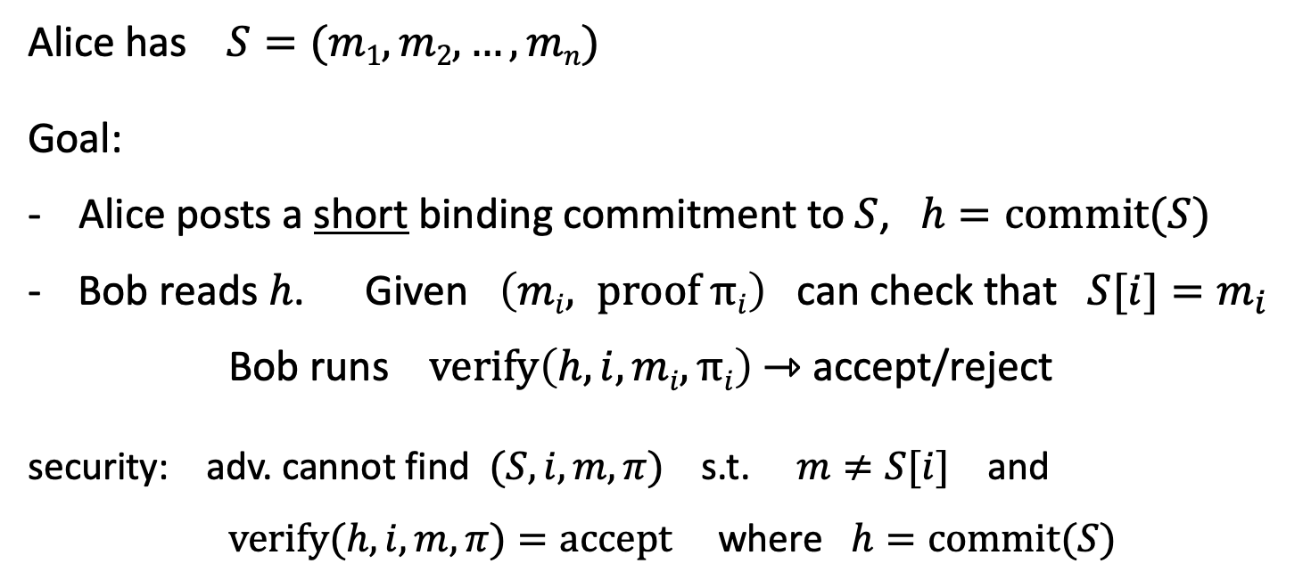
Committing to a list (of transactions)
32 bytes
Alice has $S=(m1,m2, …,mn)$
Goal:
- Alice posts a short binding commitment to $S$, $h=commit(S)$
Bob reads $h$. Given $\left(mi, proof πi\right)$ can check that $S[i]=m_{i}$
Bob runs $verify\left(h, i, mi, πi\right)$ ⇾ accept/reject
security: adv. cannot find $(S, i, m, π)$s.t. $m≠S[i]$ and $verify(h,i,m,π)=accept$where $h=commit(S)$

Slide 28
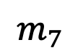
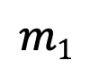
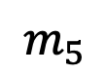

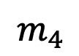
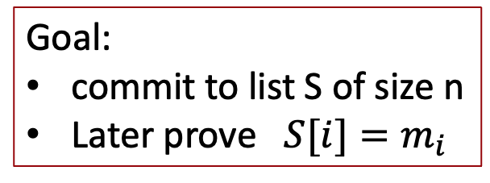
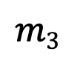
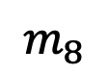
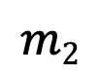
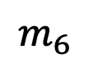
Merkle tree (Merkle 1989)
commitment
$$h$$
Goal:
commit to list S of size n
Later prove $S[i]=m_{i}$
Merkle tree commitment
$$m1$$
$$m2$$
$$m3$$
$$m_{4}$$
$$m_{5}$$
$$m_{6}$$
$$m_{7}$$
$$m_{8}$$
list of values S

Slide 29
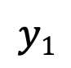
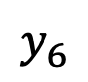
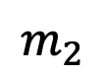
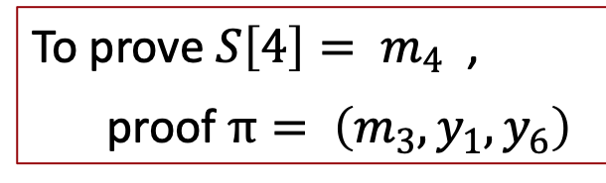
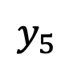
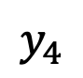
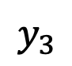

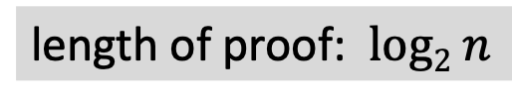
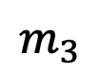
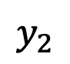
Merkle tree (Merkle 1989)
commitment
$$h$$
Goal:
commit to list S of size n
Later prove $S[i]=m_{i}$
$$y_{5}$$
H
$$y_{6}$$
H
H
$$y1$$
$$y_{2}$$
$$y_{3}$$
$$y_{4}$$
To prove ${S\left[4\right]= m}_{4}$ ,
proof $π= \left(m_{3}, y_{1}, y_{6}\right)$
H
H
H
H
$$m1$$
$$m_{2}$$
$$m_{3}$$
$$m_{4}$$
$$m_{5}$$
$$m_{6}$$
$$m_{7}$$
$$m_{8}$$
length of proof: $log2 n$
list of values S

Slide 30
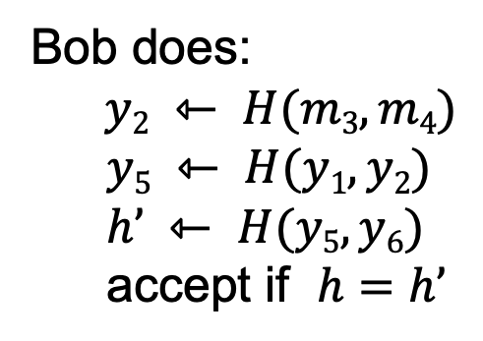
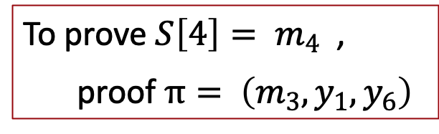
Merkle tree (Merkle 1989)
commitment
$$h$$
To prove ${S\left[4\right]= m}_{4}$ ,
proof $π= \left(m_{3}, y_{1}, y_{6}\right)$
$$y_{5}$$
H
$$y_{6}$$
H
H
Bob does:
$y2 ⇽ H(m3,m4)$
$$y5 ⇽ H(y1, y2)$$
$$h’ ⇽ H(y5, y6)$$
accept if $h=h’$
$$y1$$
$$y_{2}$$
$$y_{3}$$
$$y_{4}$$
H
H
H
H
$$m1$$
$$m_{2}$$
$$m_{3}$$
$$m_{4}$$
$$m_{5}$$
$$m_{6}$$
$$m_{7}$$
$$m_{8}$$
list of values S

Slide 31
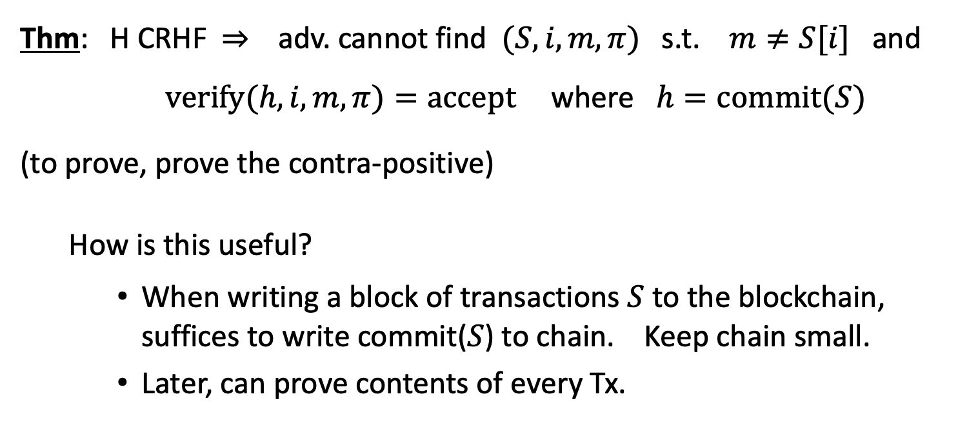
Merkle tree (Merkle 1989)
Thm: H CRHF ⇒ adv. cannot find $(S, i, m, π)$s.t. $m≠S[i]$ and $verify(h,i,m,π)=accept$where $h=commit(S)$
(to prove, prove the contra-positive)
How is this useful?
When writing a block of transactions $S$ to the blockchain, suffices to write commit($S$) to chain. Keep chain small.
Later, can prove contents of every Tx.
Super useful. Example

Slide 32
Abstract block chain
blockchain
block header
block header
block header
⊥
Merkle root
other data
hash
Merkle root
other data
hash
Merkle root
other data
Merkle tree
Merkle tree
Merkle tree
Tx₁ Tx₂ … Tx_{n}
Tx₁ Tx₂ … Tx_{n}
Tx₁ Tx₂ … Tx_{n}
Merkle proofs are used to prove that a Tx is “on the block chain”

Slide 33
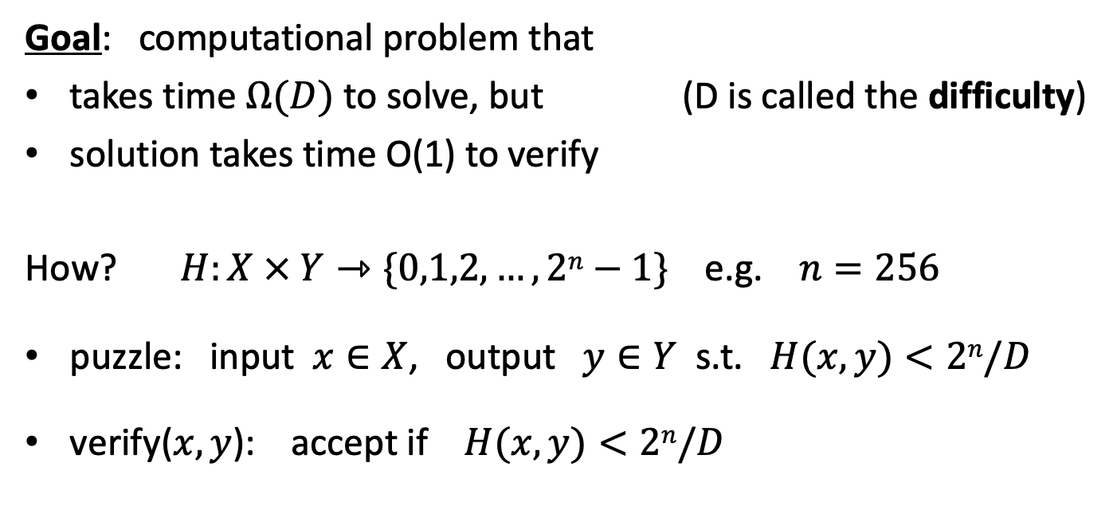
Another application: proof of work
Goal: computational problem that
takes time $Ω(D)$ to solve, but (D is called the difficulty)
solution takes time O(1) to verify
How? $H:X × Y⇾\{0,1,2,…,2n−1\}$ e.g. $n=256$
puzzle: input $x∈X$, output $y∈Y$ s.t. $H(x,y)<2n/D$
verify($x,y$): accept if $H(x,y)<2n/D$

Slide 34
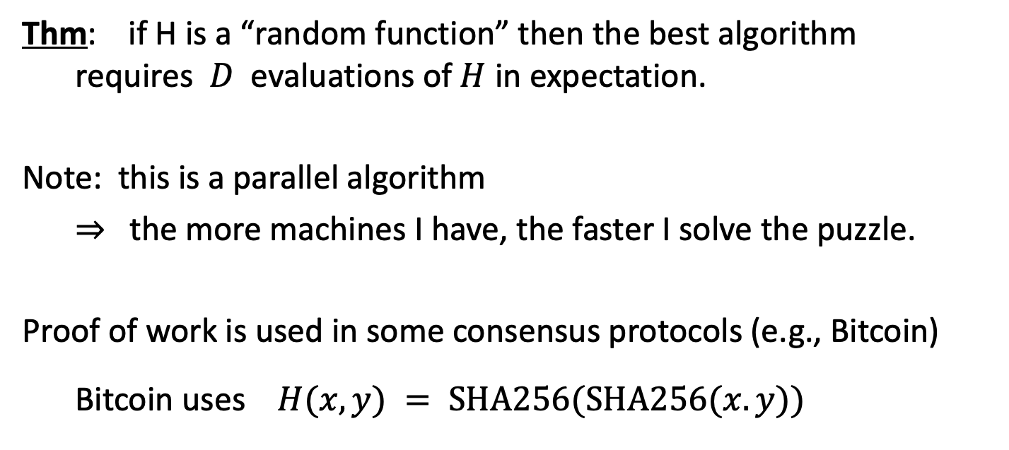
Another application: proof of work
Thm: if H is a “random function” then the best algorithm requires $D$ evaluations of $H$ in expectation.
Note: this is a parallel algorithm
⇒ the more machines I have, the faster I solve the puzzle.
Proof of work is used in some consensus protocols (e.g., Bitcoin)
Bitcoin uses $H(x,y) = SHA256(SHA256(x.y))$

Slide 35
Cryptography background: Digital Signatures
How to authorize a transaction

Slide 36
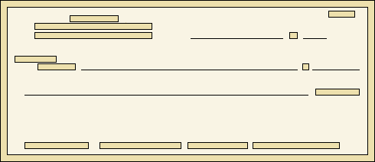
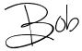
Signatures
Physical signatures: bind transaction to author
Bob agrees to pay Alice 1$
Bob agrees to pay Alice 100$
Problem in the digital world:
anyone can copy Bob’s signature from one doc to another
Notes:
Bad example: will see why on the last slide of this segment.

Slide 37
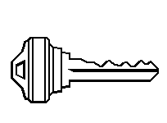
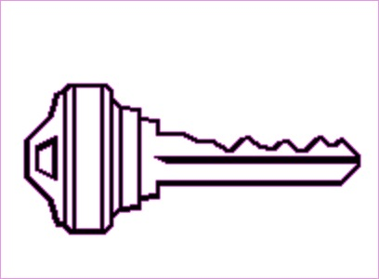
Digital signatures
Solution: make signature depend on document
Signer
Verifier
‘accept’
or
‘reject’
Bob agrees to pay Alice 1$
verifier
signature
signing
algorithm
secret signing key (sk)
public verification key (pk)

Slide 38
Digital signatures: syntax
Def: a signature scheme is a triple of algorithms:
Gen(): outputs a key pair (pk, sk)
Sign(sk, msg) outputs sig. σ
Verify(pk, msg, σ) outputs ‘accept’ or ‘reject’
Secure signatures: (informal)
Adversary who sees signatures on many messages of his choice, cannot forge a signature on a new message.

Slide 39
Families of signature schemes
RSA signatures (old … not used in blockchains):
long sigs and public keys (≥256 bytes), fast to verify
Discrete-log signatures: Schnorr and ECDSA
short sigs (48 or 64 bytes) and public key (32 bytes)
BLS signatures: 48 bytes, aggregatable, easy threshold
Post-quantum signatures: long (≥768 bytes)
(Bitcoin, Ethereum)
(Ethereum 2.0, Chia, Dfinity)
details in CS255

Slide 40
Signatures on the blockchain
Signatures are used everywhere:
ensure Tx authorization,
governance votes,
consensus protocol votes.
verifyTx
verifyTx
verify Tx
sk₁
data
signatures
sk₂
data
signatures

Slide 41
END OF LECTURE
Next lecture: the Bitcoin blockchain

